Slide 1
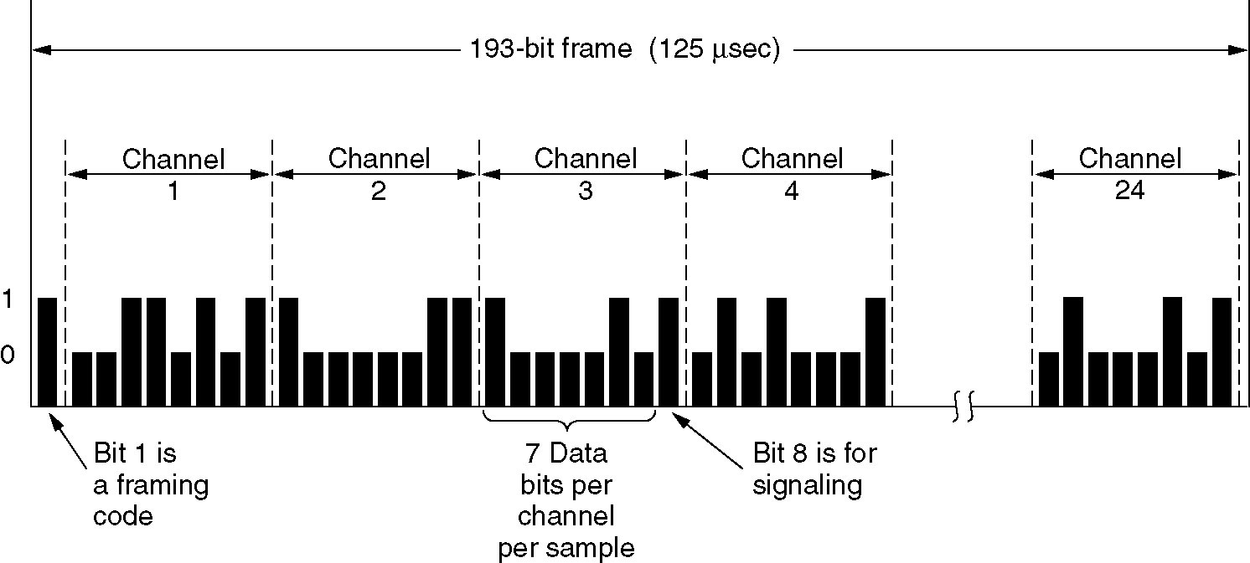
Time Division Multiplexing
Frame consists of 24x8 = 192 bits + 1 bit for framing
  Extra bit used for frame synchronization
  193 bits x 125 μsec/sample = 1.544 Mbps

Slide 2
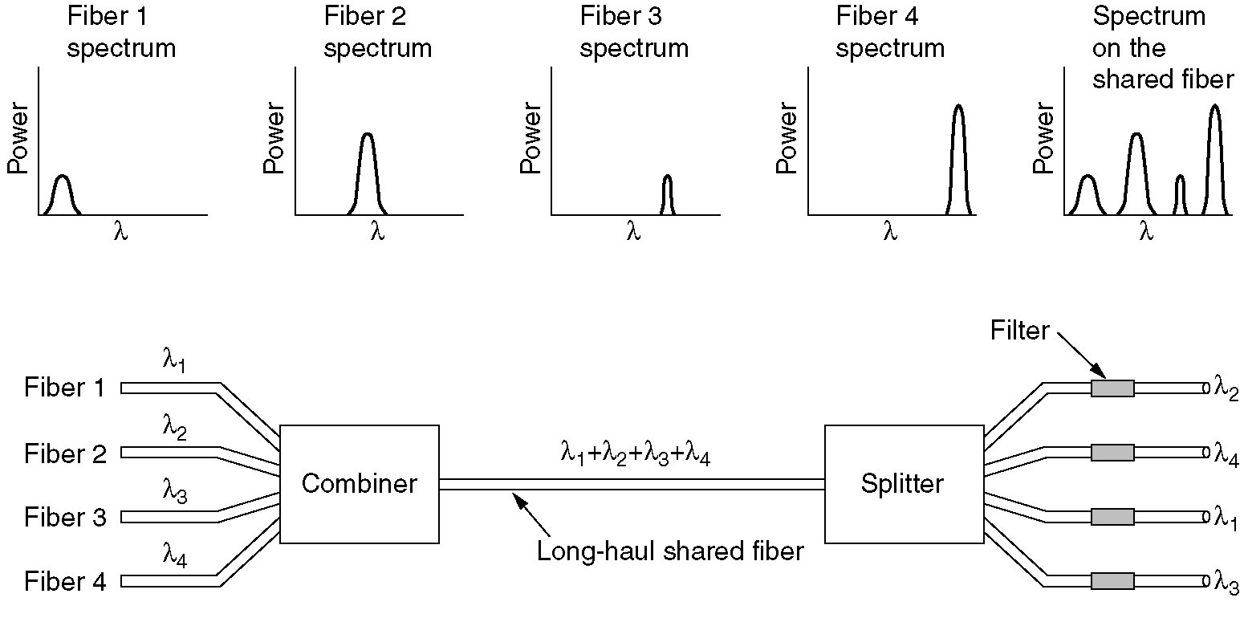
Wavelength Division Multiplexing

Slide 3
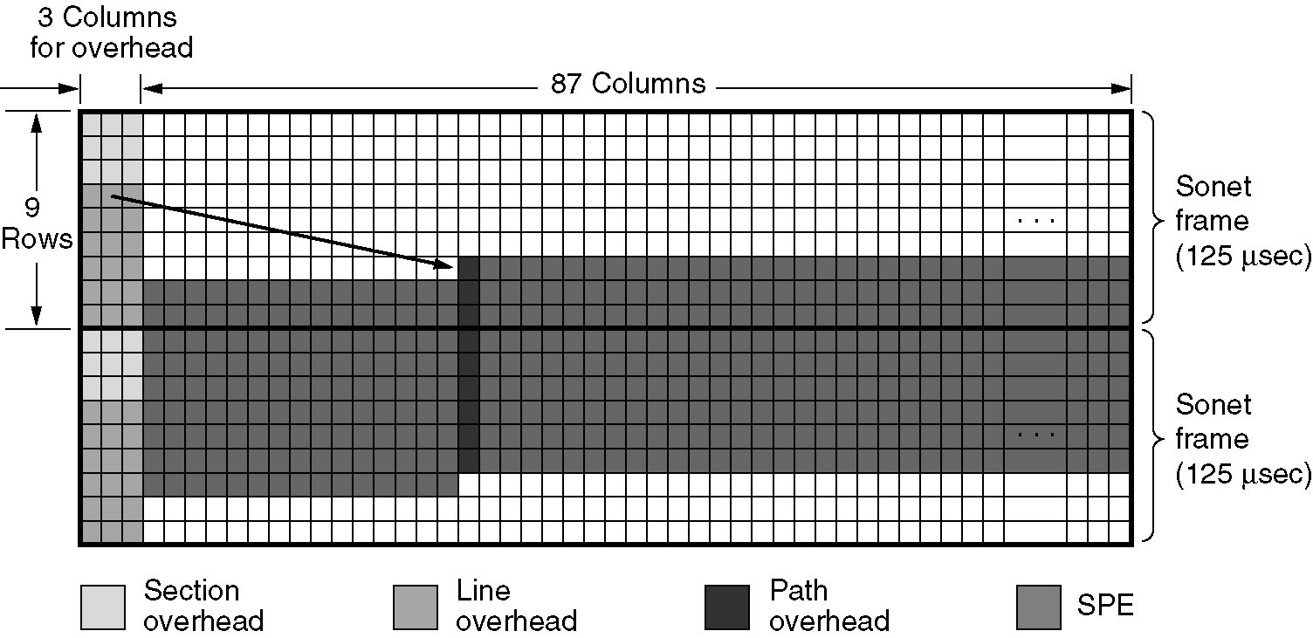
Example of Back-to-Back SONET Frames
  Columns 1-3 are reserved for system management (overhead)
  Rows 1-3 are reserved for section overhead
    Generated and checked at start and end of each section
  Rows 4-9 are reserved for line overhead
    Generated and checked at the start of each line
    First row of line overhead points to start of user data

Slide 4
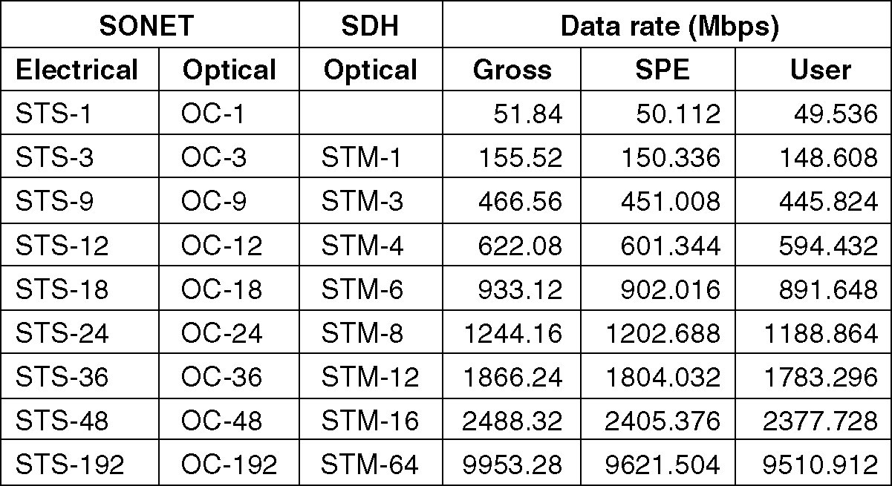
SONET/SDH
SONET and SDH multiplex rates.

Slide 5
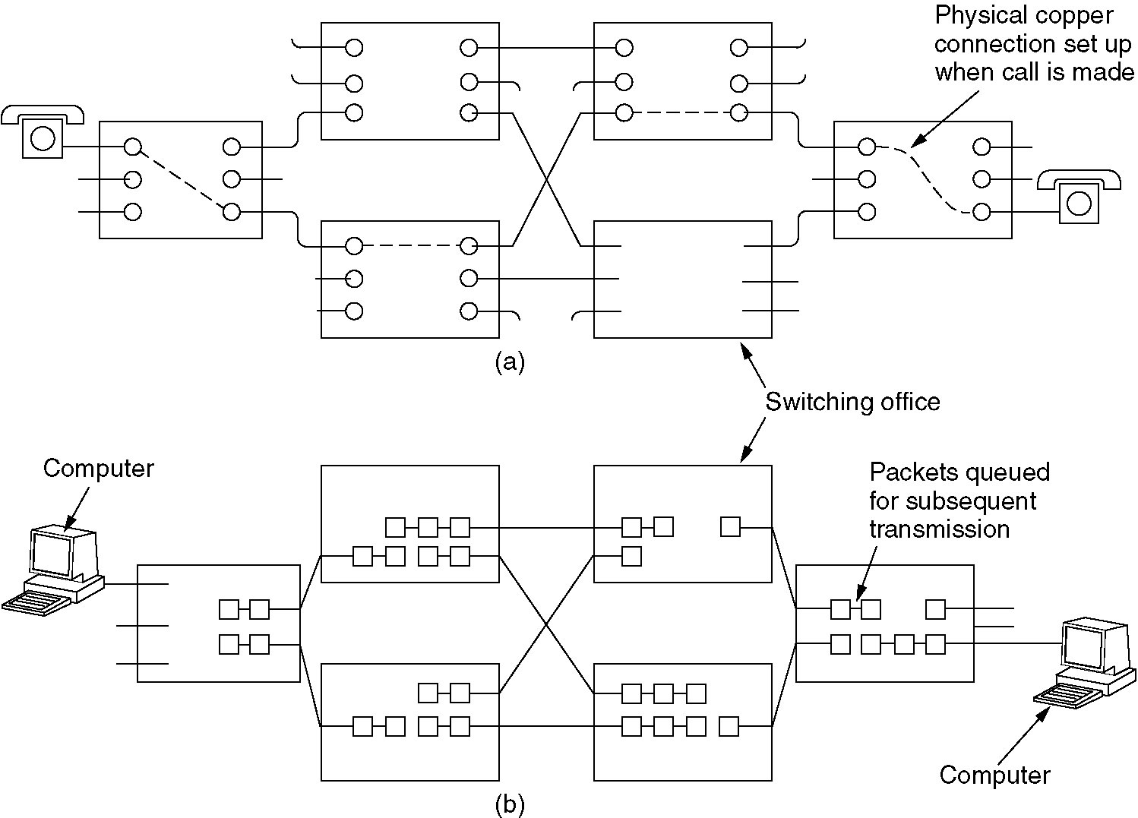
Circuit Switching
(a) Circuit switching
(b) Packet switching

Slide 6
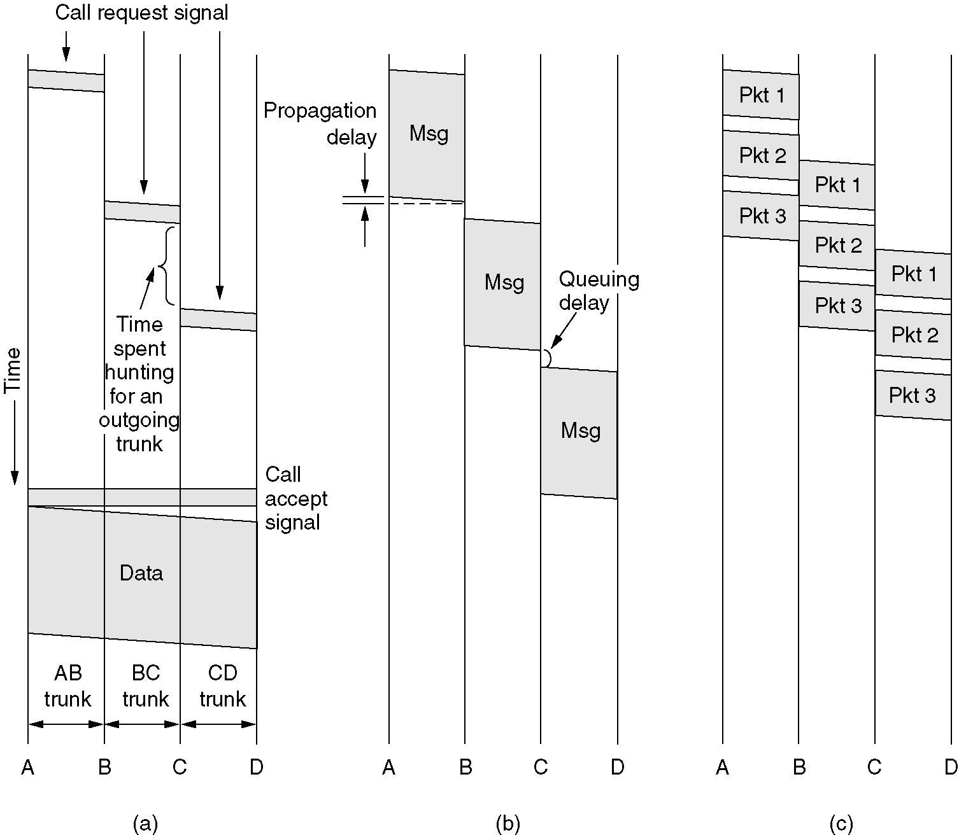
Message Switching
(a) Circuit switching (b) Message switching (c) Packet switching

Slide 7
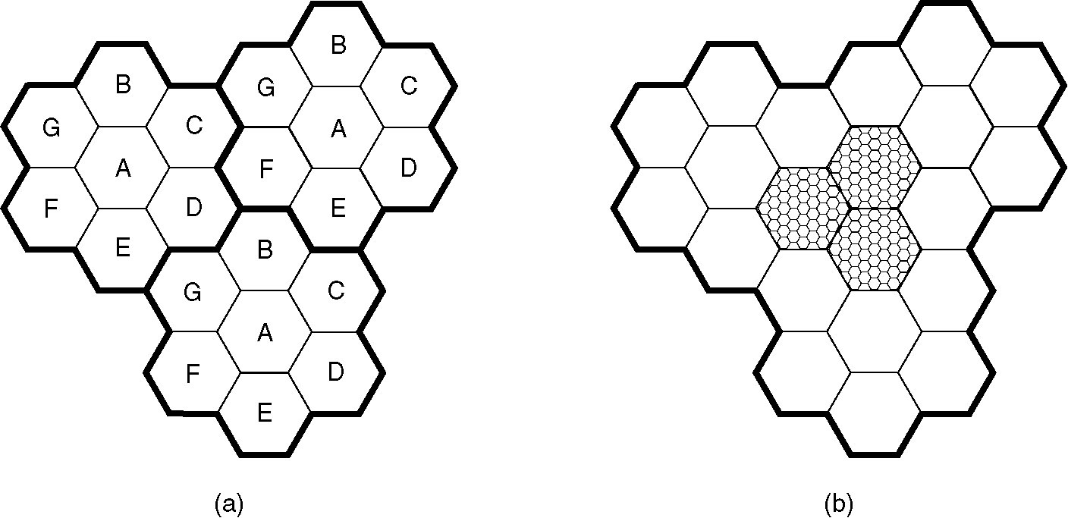
Advanced Mobile Phone System
(a) Frequencies are not reused in adjacent cells.
(b) To add more users, smaller cells can be used.

